Slide 1


DIABETES PREDICTION USING THE SUPPORT VECTOR MACHINE ALGORITHM WITH TECHNIQUES Feature Selection

Slide 2


YULI ASTI PUTRI
A Bachelor's student in Information Systems at Universitas Teknokrat Indonesia. Currently focusing on web design and data science, with strong skills in using tools and platforms such as Microsoft Office, Tableau, and Google Colab. Passionate about combining creativity and analytical thinking to create innovative solutions in the field of information technology.

Slide 3


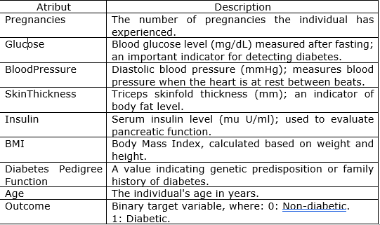
Creative Portfolio
Yuli Asti Putri
DATASET DESCRIPTION
The dataset used in this project is obtained from open source on Kaggle, which contains medical information related to diabetes. The dataset consists of 769 records with 10 relevant attribute columns
his dataset has gone through a preprocessing process to ensure that the data is clean and ready for further analysis.
Page 03 of 24

Slide 4






Creative Portfolio
Yuli Asti Putri
TOOLS USED
Page 04 of 25

Slide 5
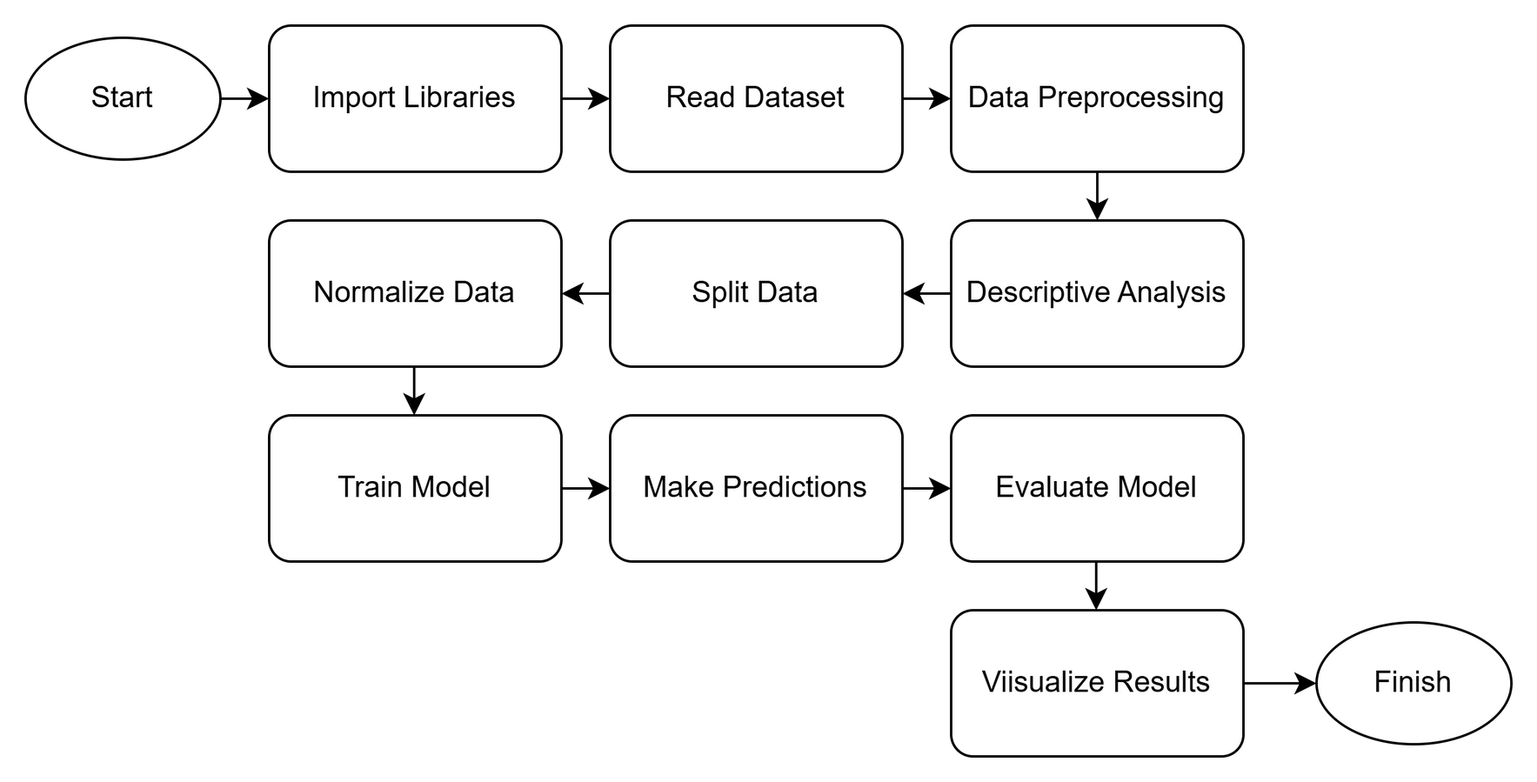
Creative Portfolio
Yuli Asti Putri
FLOWCHART ML
Page 05 of 24

Slide 6
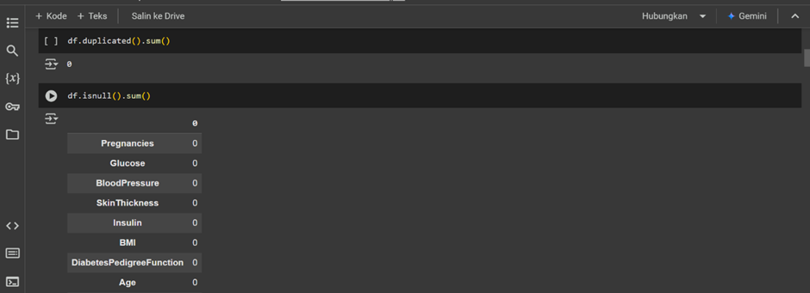
Creative Portfolio
Yuli Asti Putri
EXPLORATORY DATA ANALYSIS (EDA)
Page 06 of 24

Slide 7
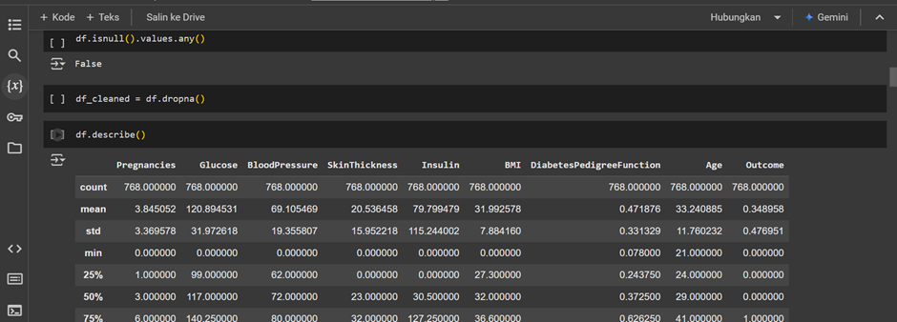
Creative Portfolio
Yuli Asti Putri
EXPLORATORY DATA ANALYSIS (EDA)
Page 07 of 24

Slide 8
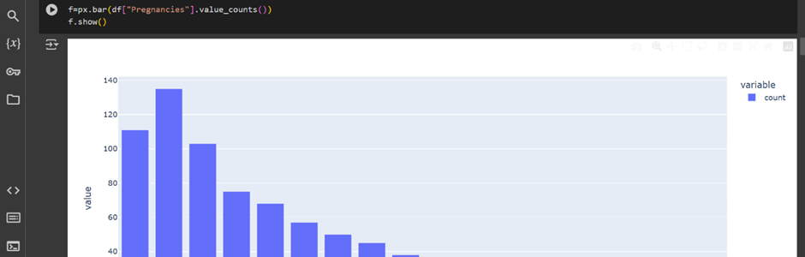
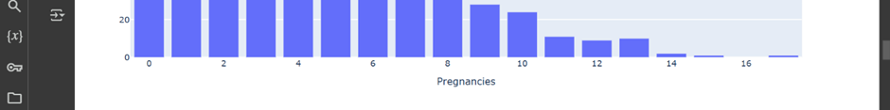
Creative Portfolio
Yuli Asti Putri
EXPLORATORY DATA ANALYSIS (EDA)
Page 08 of 24

Slide 9
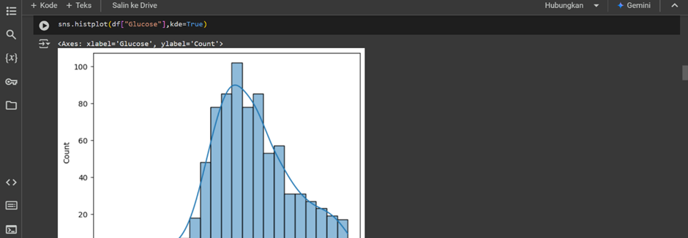
Creative Portfolio
Yuli Asti Putri
EXPLORATORY DATA ANALYSIS (EDA)
Page 09 of 24

Slide 10
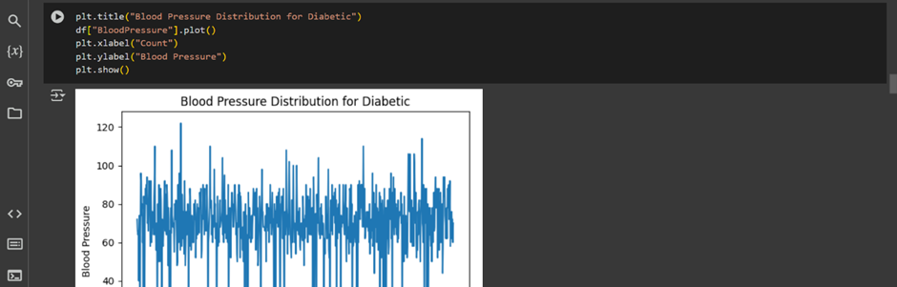

Creative Portfolio
Yuli Asti Putri
EXPLORATORY DATA ANALYSIS (EDA)
Page 10 of 24

Slide 11
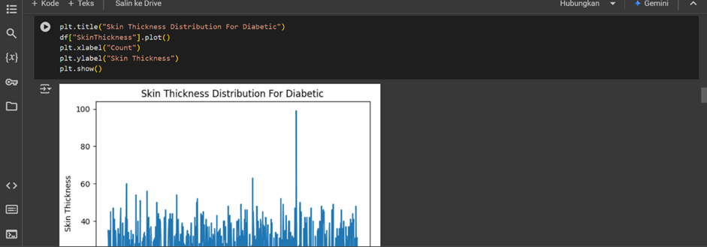
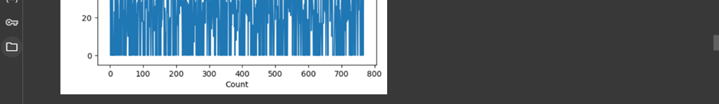
Creative Portfolio
Yuli Asti Putri
EXPLORATORY DATA ANALYSIS (EDA)
Page 11 of 24

Slide 12
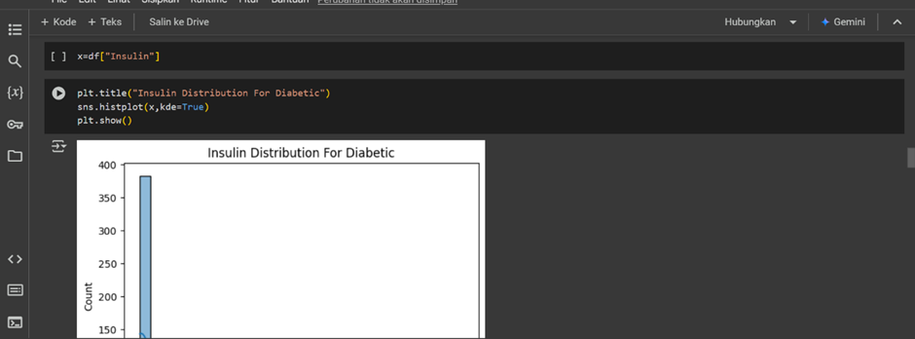
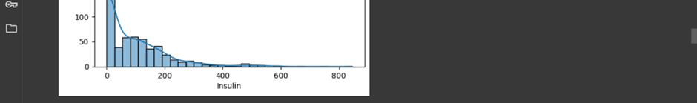
Creative Portfolio
Yuli Asti Putri
EXPLORATORY DATA ANALYSIS (EDA)
Page 12 of 24

Slide 13
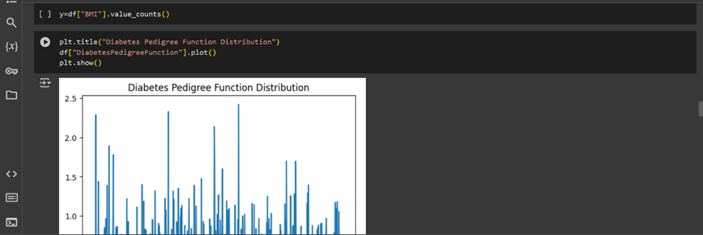
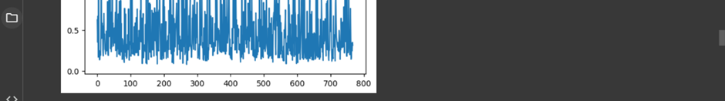
Creative Portfolio
Yuli Asti Putri
DATA VISUALIZATION
Page 13 of 25

Slide 14
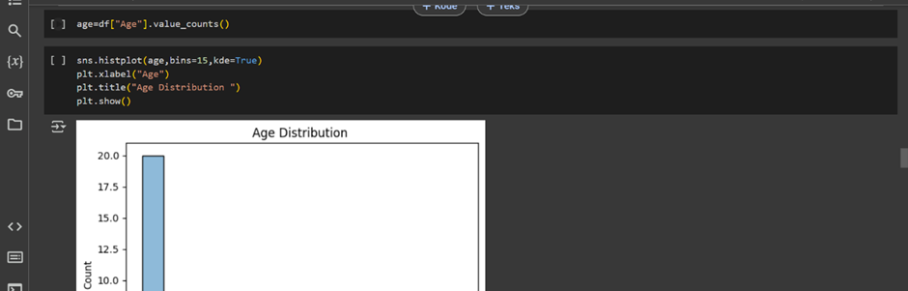
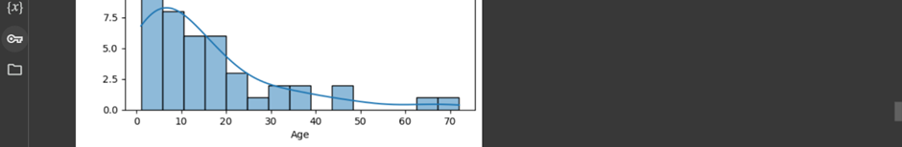
Creative Portfolio
Yuli Asti Putri
DATA VISUALIZATION
Page 14 of 25

Slide 15
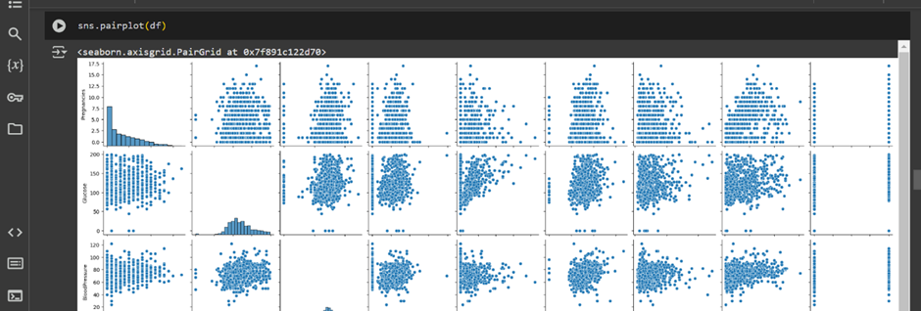
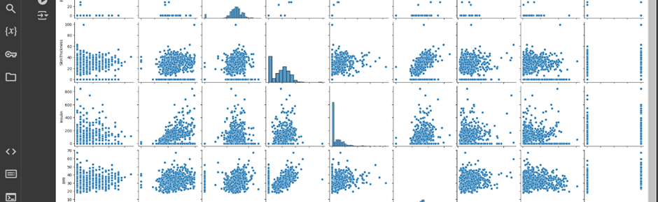
Creative Portfolio
Yuli Asti Putri
DATA VISUALIZATION
Page 15 of 24

Slide 16
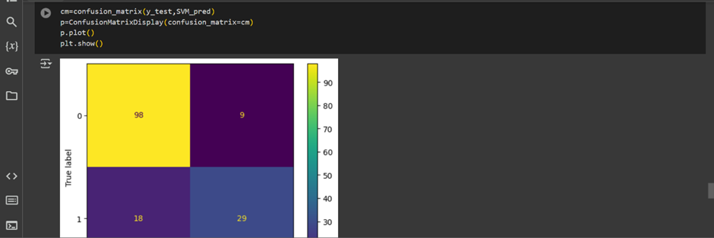
Creative Portfolio
Yuli Asti Putri
DATA VISUALIZATION
Page 16 of 24

Slide 17
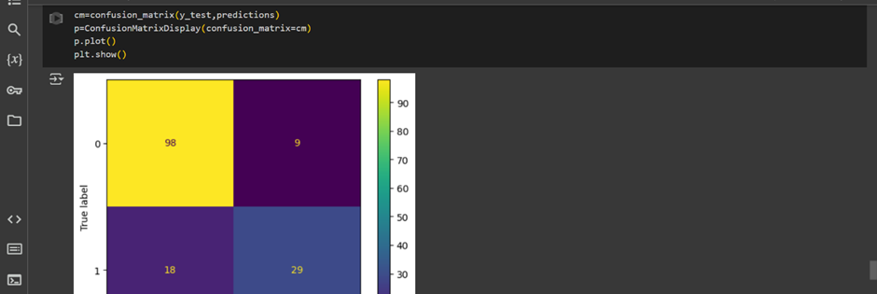

Creative Portfolio
Yuli Asti Putri
DATA VISUALIZATION
Page 17 of 24

Slide 18
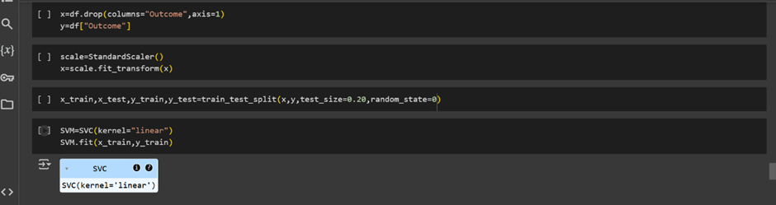
Creative Portfolio
Yuli Asti Putri
DATA MODELLING
Page 18 of 24

Slide 19
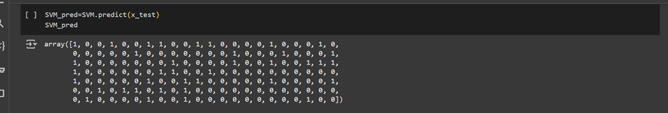
Creative Portfolio
Yuli Asti Putri
DATA MODELLING
Page 19 of 24

Slide 20
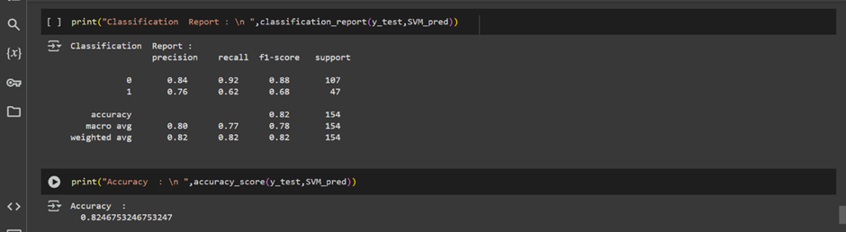
Creative Portfolio
Yuli Asti Putri
DATA MODELLING
Page 20 of 24

Slide 21
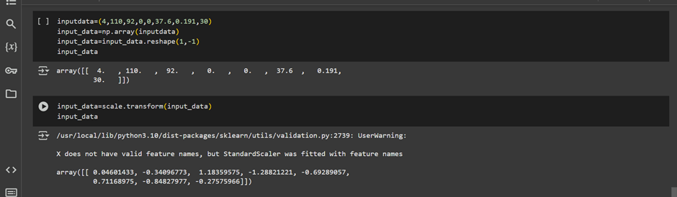
Creative Portfolio
Yuli Asti Putri
DATA MODELLING
Page 21 of 24

Slide 22
Creative Portfolio
Yuli Asti Putri
DATA MODELLING
Page 22 of 24

Slide 23

Creative Portfolio
Yuli Asti Putri
CONCLUSION
This project successfully developed a machine learning model using Support Vector Machine (SVM) to predict diabetes based on a medical dataset. Here’s a brief summary of the process and results:Data Preparation: The dataset contains 768 entries with 8 medical features, which were cleaned and processed for analysis.
Model Training: The dataset was split into training and testing sets, and the SVM model was trained using a linear kernel.
Model Evaluation: The model's performance was evaluated using accuracy metrics and confusion matrices, showing satisfactory results in predicting diabetes.
Visualization: Evaluation results were visualized to provide a clearer understanding of the model's performance.
Overall, this project demonstrates the effectiveness of SVM in diagnosing diabetes, highlighting its potential applications in healthcare.
Page 23 of 24

Slide 24
Creative Portfolio
Yuli Asti Putri
Let's work
TOGETHER
+62 895-2201-5780
yuliastiputri@gmail.com
https://github.com/Putri0607
Page 24 of 24

